Slide 1
Bayesian Statistics
Introduction

Slide 2
Syllabus
Probability
Random variables
Probability distributions
Statistics, parameters
Bayesian models
Generative model
Likelihood
Prior
Simulation
4. Bayesian inference
Bayes' rule
Conjugate models
5. MCMC
6. Bayesian decision
Decision theory
Loss functions
Hypothesis tests
Bayes factor

Slide 3
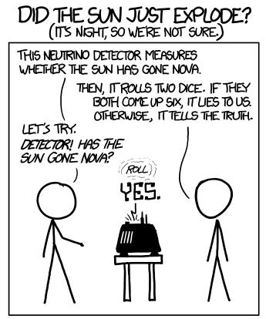
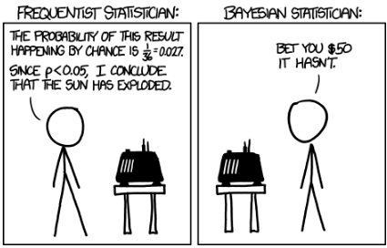
Evaluation
Homework (10%)
Exam (Large homework)
Presentation

Slide 4
Introduction

Slide 5
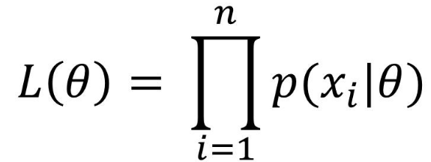
Statistics Review Frequentist

Slide 6
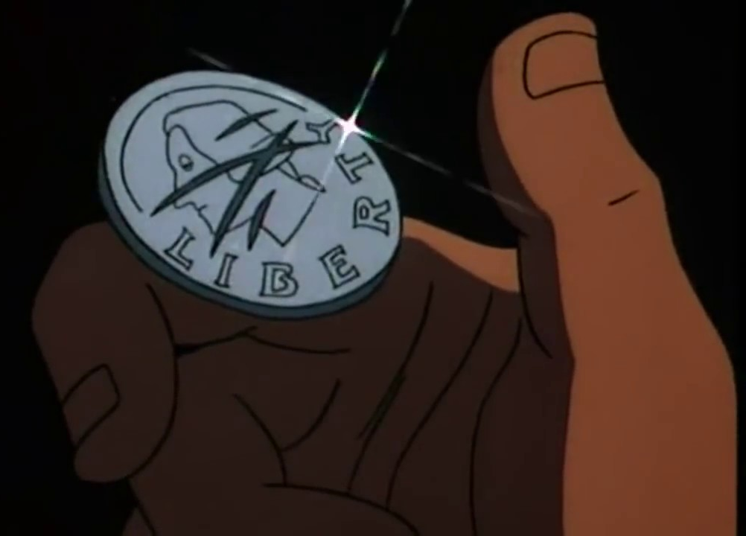
Coin example
Experiment:
We flip a coin 10 times
Question:
Is the coin fair?
Data:
Heads, Tails, Tails, Tails, Heads, Tails, Tails, Heads, Heads, Tails

Slide 7
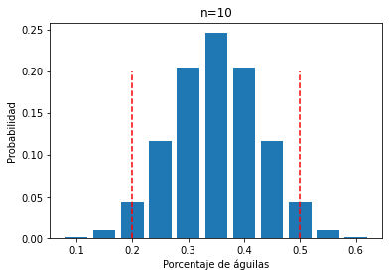
Frequentist answer
Hypothesis:
The coin is fair
Data:
Heads, Tails, Tails, Tails, Heads, Tails, Tails, Heads, Heads, Tails

Slide 8
Frequentist procedure
Likelihood model of the data

Slide 9
Frequentist answer
Hypothesis:
The coin is fair
Data:
Heads, Tails, Tails, Tails, Heads, Tails, Tails, Heads, Heads, Tails
Conclusion:
We fail to reject the null hypothesis. Equivalently,
the data do not provide sufficient evidence at the 5% level to conclude the coin is unfair (which is not the same as evidence that it is fair)

Slide 10
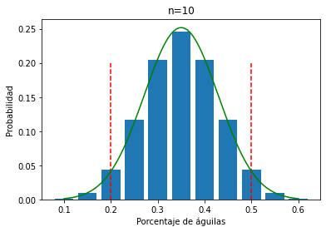
Frequentist answer
Hypothesis:
The coin is fair
Data:
Heads, Tails, Tails, Tails, Heads, Tails, Tails, Heads, Heads, Tails
Conclusion:
We fail to reject the null hypothesis. Equivalently,
the data do not provide sufficient evidence at the 5% level to conclude the coin is unfair (which is not the same as evidence that it is fair)

Slide 11
Frequentist procedure
Likelihood model of the data
H0 is rejected or not rejected

Slide 12
Confidence intervals
The parameter is between 2 and 8 with 95% confidence

Slide 13
Frequentist procedure
Likelihood model of the data
H0 is rejected or not rejected
Confidence intervals

Slide 14
Confidence intervals — Meaning
With a 95% confidence interval
If we ran 100 identical experiments
And the null hypothesis were true
Then 95% of the time the value would fall in that interval
Colloquial interpretation:
Either the true parameter is there or we had very bad luck in our experiment

Slide 15
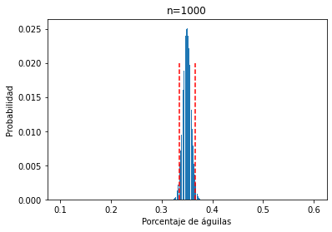
Instead of running 10 experiments...
We can run a single experiment of 1000 coin flips
The confidence interval is smaller

Slide 16
Frequentist procedure
Power of the test
How confident do I want/can I be in my answer?
Likelihood model of the data
H0 is rejected or not rejected
Confidence intervals

Slide 17
Example with a die
Experiment:
We roll a die 10 times
Question:
Is the die fair?
Data:
1, 5, 2, 5, 3, 2, 6, 3, 4, 4, 1

Slide 18
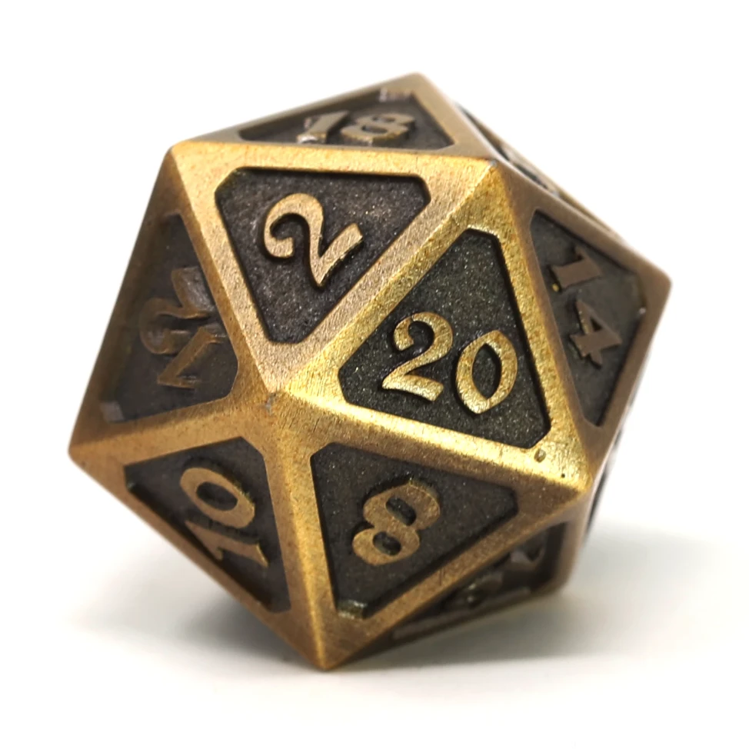
Example with a die
Experiment:
We roll a die 10 times
Question:
Is the die fair?
Data:
1, 5, 2, 5, 3, 2, 6, 3, 4, 4, 1

Slide 19
Stated problems
The interpretation is misleading
Reject vs do not reject
It says nothing about H0
Interpretation alone is not enough
Power must be computed
It is permissive about modeling
We can compute things "easily" and interpret without worrying about the model
None of this is wrong per se. But it can cause problems in mechanical practice.
p-hacking
Confusing the p value or confidence intervals with probability
Jumping quickly to compute metrics without thinking about the real mechanism

Slide 20
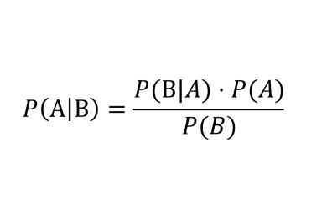
Motivation
Bayesian

Slide 21
Bayesian case
What you get from Bayesian inference is a probability of the hypothesis given the data.
Something that seems like a holy grail from the frequentist perspective.
A = Hypothesis
B = Data
P(B|A) = Likelihood
P(A) = Prior
P(A|B) = Posterior

Slide 22
The Prior distribution
It is the biggest difference from the frequentist approach
It is often called "subjective"
Main criticism
Prior experience / expert opinion
Changes the conversation from: did you check your model's assumptions?
...to: why did you choose that distribution? why do you expect that to happen?

Slide 23
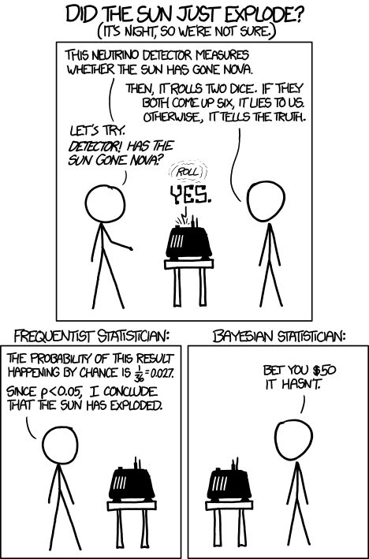
Decision theory
Bayesian theory focuses on making rational decisions
It provides a consistent theoretical framework to justify these decisions
Need to define a utility (or loss) function

Slide 24
What will we discover?
In frequentist it is "easy" to model and compute, hard to interpret
In Bayesian it is hard to model and compute, the interpretation is "intuitive"
Frequentist vs Bayesian

